Slide 1
Urbanization and Urban Networks
APHUG

Slide 2
Urban Beginnings
From villages to cities
Population: Villages had under 1000 ppl, cities had thousands
Population density: several thousand ppl per sq. mile
Non-agricultural population: there was a bit of farmland but needed to be fed by those in the countryside
Specialization: metal workers, scribes, tanner
Centers: cities were important center of economic, cultural and political life.

Slide 3
Agriculture
1. required settling down, settlements were built with permanent material
2. population densities increased bc/ ppl obtained food from land
3. Food surpluses allowed for trade and storage
4. Food was on a regular schedule
5. Division of labor

Slide 4
FIRST CITIES
1. Sumeria 4750 BCE
2. Diffused to Egypt 3000 BCE
3. Diffused to Pakistan 2250 BCE
4. Independent cities appeared in China 1500 BCE
5. Southern Mexico 1CE

Slide 5
Hinterland: area surrounding the city from which it obtains food.
Cities were constrained by transportation, access to food sources, and other cities.
Iron helped for better wheels and ships
Cities initiated development of road networks and sea lanes for easier travel and access to resources.
Transportation routes allowed the diffusion of new cities

Slide 6
Early cities were actually city-states
These city states then wanted to conquer more land that was urbanized. Akkadian Kingdom controlled Sumerian city-states. Mycanean, Persian, Carthaginian 5-6th century BCE.
These city-states became territorial states, which managed the city states and the hinterland.]
Expansion of political states became empires like the Roman Empire in the Mediterranean, Han in China, Axum in Ethiopia.

Slide 7
Empires
Imperial capitals were large
Rome had 1 million people by 150 AD
Baghdad the capital of the Islamic Caliphate had 1 million as well.
Empire were engines of urban development. Divided into provinces headed by a capital.
Rome was secured by establishment of cities linked by roads and allowed for the efficient collection of taxes

Slide 8
Urbanization and Capitalism
Urbanization: refers to the increase in the percentage of people who live within cities. From rural to urban
Cities had society’s elite, merchants, tradespeople and artisans and lived in these political capitals.
Situation factors changed. At first cities needed control of the hinterland but later they were more interested in the political control of their empires.
After the fall of Roman empire Rome lost 80% of the population in the 1st century.

Slide 9
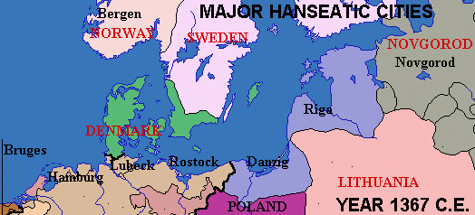
The reliance of commerce altered the situation of new capitalist cities.
Cities needed access to raw material, agricultural materials , market and trading routes
Urban network: cities tied together in some meaningful way (functional linkage) like key trading routes
Examples-Hanseatic league: trade in bulk goods like fur, wool, herring , beer. Hanseatic cities had their own legal system and furnished their own armies for mutual protection and aid.

Slide 12
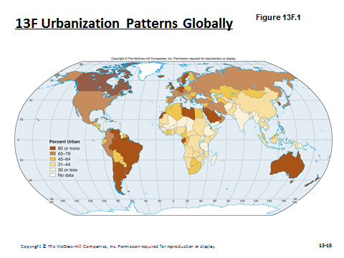

Slide 13
13G: Agglomeration Economies & Urban Functions
Different economic activities tend to locate near each other, which in turn can attract other activities (see Module 16.E)
The linkages between urban functions within a city were complemented by more connections among cities
More and more cities began specializing in a particular industry
Boston: Universities
Pittsburgh: Steel
Los Angeles: Film & TV

Slide 14
13H: Urban Hierarchies & the Rank-Size Relationship 1
Within an urban network there is an urban hierarchy, i.e. not all cities are of equal size or importance
Some regions have an urban hierarchy represented by a rank-size relationship
Population of City_{r}=Population of City¹/r

Slide 15
13H: Urban Hierarchies & the Rank-Size Relationship 2
Some countries have one city that is disproportionally large, called a primate city
Primate cities are often the cultural and economic hub
Primate can form because they were once the capital of a larger area or because there is uneven development in the country
Other countries have binary trinary rank-size distributions, where 2 or 3 cities dominate

Slide 16
A world city is a city at the top of the global hierarchy New York, London, Tokyo

