Slide 1
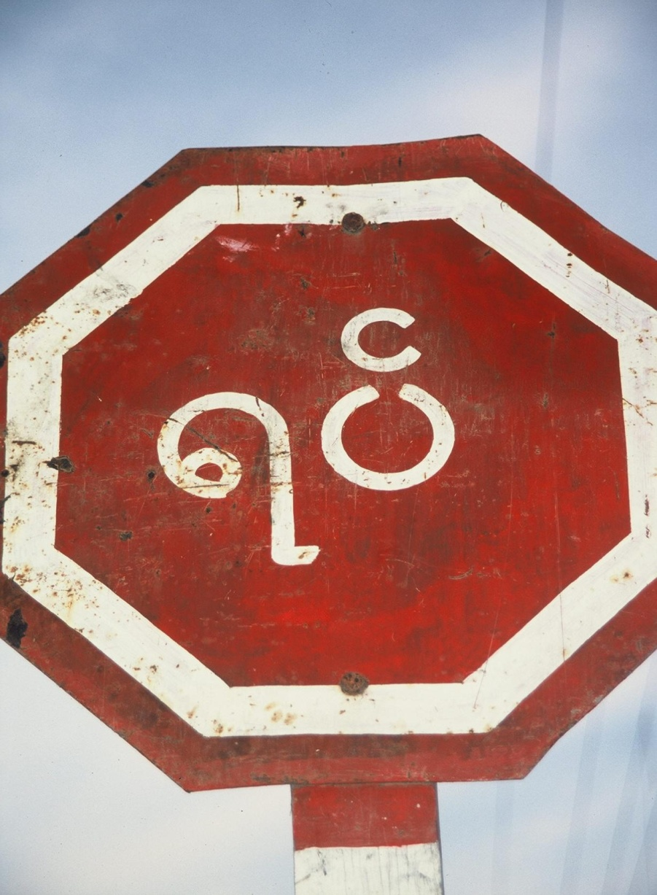
Language
Concept Caching:
Burmese Script -Burma
© Barbara Weightman

Slide 2
Field Note: What Should I Say?
“In stores throughout Brussels, Belgium, you can see the capital city’s bilingualism all around you—literally. From McDonald’s to health insurance offices to the metro, signs in Brussels are posted in duplicate, with one in Flemish (a variant of Dutch) and one in French.”
Notes:
*Could be an audio file.
Figure 6.1
Brussels, Belgium. A health insurance offi ce in the bilingual capital city of Brussels displays
duplicates of each of their posters, one in French and one in Flemish. © Erin H. Fouberg.

Slide 3
Key Question
What Are Languages, and What Role Do Languages Play in Cultures?

Slide 4
What Are Languages, and What Role Do Languages Play in Cultures?
Language is a set of sounds and symbols that is used for communication.
Language is an integral part of culture.
Language and Culture
Language reflects where a culture has been and what it values.
Language makes people in a culture visible to each other and to the world.

Slide 5
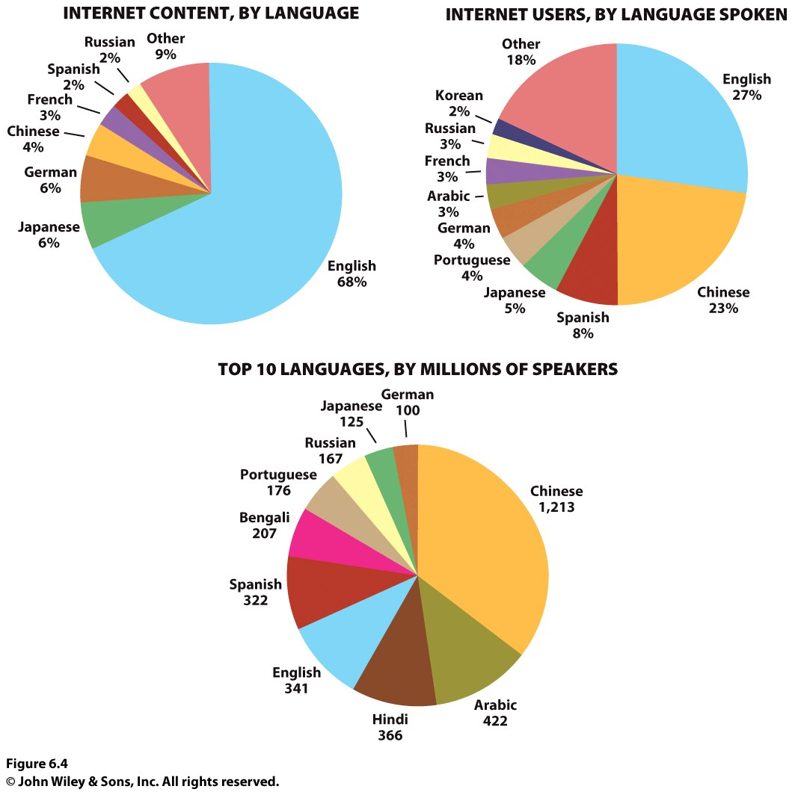

Slide 6
What Are Languages, and What Role Do Languages Play in Cultures?
Language and Culture
American, Canadian, Australian, Russian, and New Zealand governments had policies of forced assimilation during the twentieth century, including not allowing indigenous peoples to speak native languages.
Language is so closely tied to culture that people use language as a weapon in cultural conflict and political strife.
Notes:
Figure 5.2
United States. Although biologically there is only one human
race, we are constantly asked to choose race “boxes” for ourselves.
This page of the 2010 United States Census asks the
individual, “What is your race?” and directs the individual to
“Mark one or more races to indicate what you consider yourself to be.” © U.S. Census Bureau

Slide 7
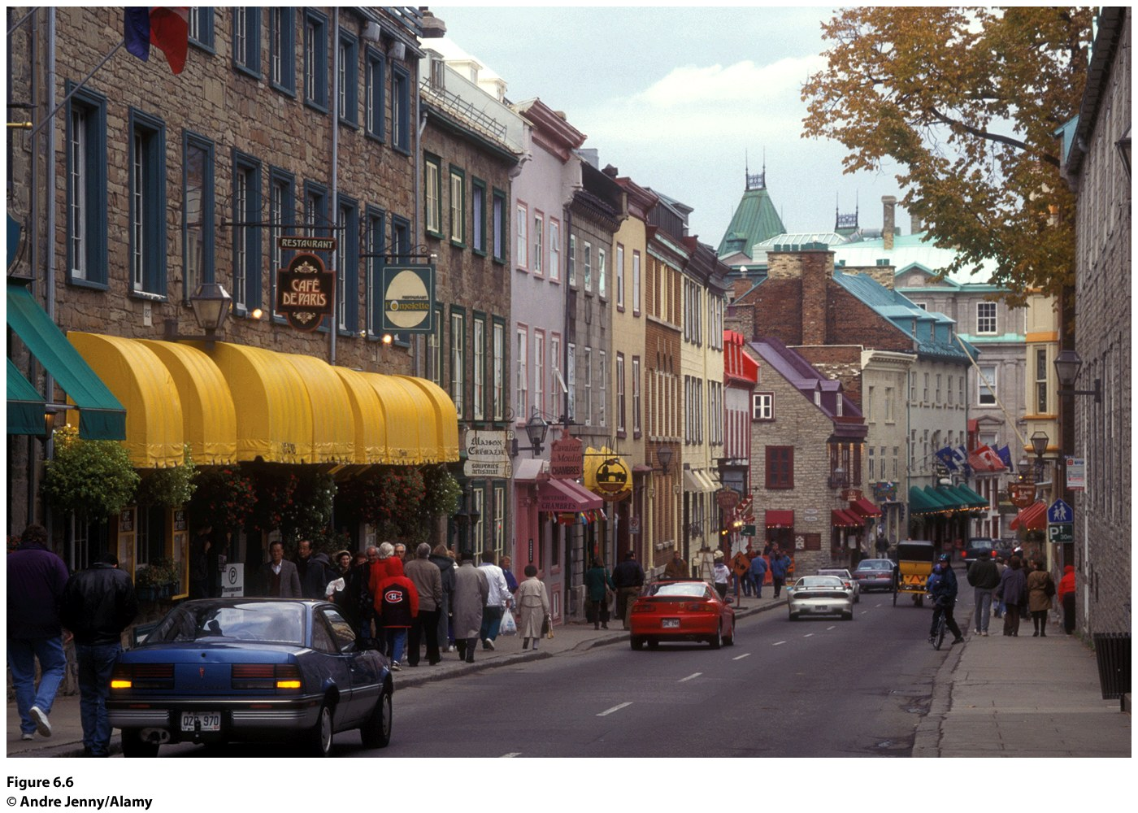
In 1993, the Quebec government passed a law requiring the use of French in advertising.
Notes:
Figure 6.6
Quebec Province, Quebec. The imprint
of the French Canadian culture is evident
in the cultural landscape of Rue Saint-Louis
in Quebec. Here, the architecture and
store signs confi rm that this region is not
simply Canadian; it is French Canadian.
© Andre Jenny/Alamy.

Slide 8
What Are Languages, and What Role Do Languages Play in Cultures?
What Is a Language?
Mutual intelligibility:
Two people can understand each other when speaking.
Is almost impossible to measure.
Some languages are separate but are mutually intelligible.
Decision of what a standard language will be has to do with influence and power.
Standard Language: language that is published, distributed and taught in a country.

Slide 9
Bilingualism in America
Standard Language examples
China: Northern mandarin
UK: PRB English for the well educated
France-French regulated bvy the AcademieFrancaise
In Ireland- you ned to pass an Irsh exam to get a government job
Bilingualism: when 2 languages are spoken and are promoted.
Hawaii - English and Hawaiian pidgin
New Mexico-English and Spanish

Slide 10
What Are Languages, and What Role Do Languages Play in Cultures?
Dialects
Variants of a standard language along regional or ethnic lines
Differences in vocabulary, syntax, pronunciation, cadence, and pace of speech
Dialect chains:a set of contiguous dialects in which the dialects nearest to each other at any place in the chain are most closely related
Isogloss: geographic boundary within which a particular linguistic feature occurs

Slide 11
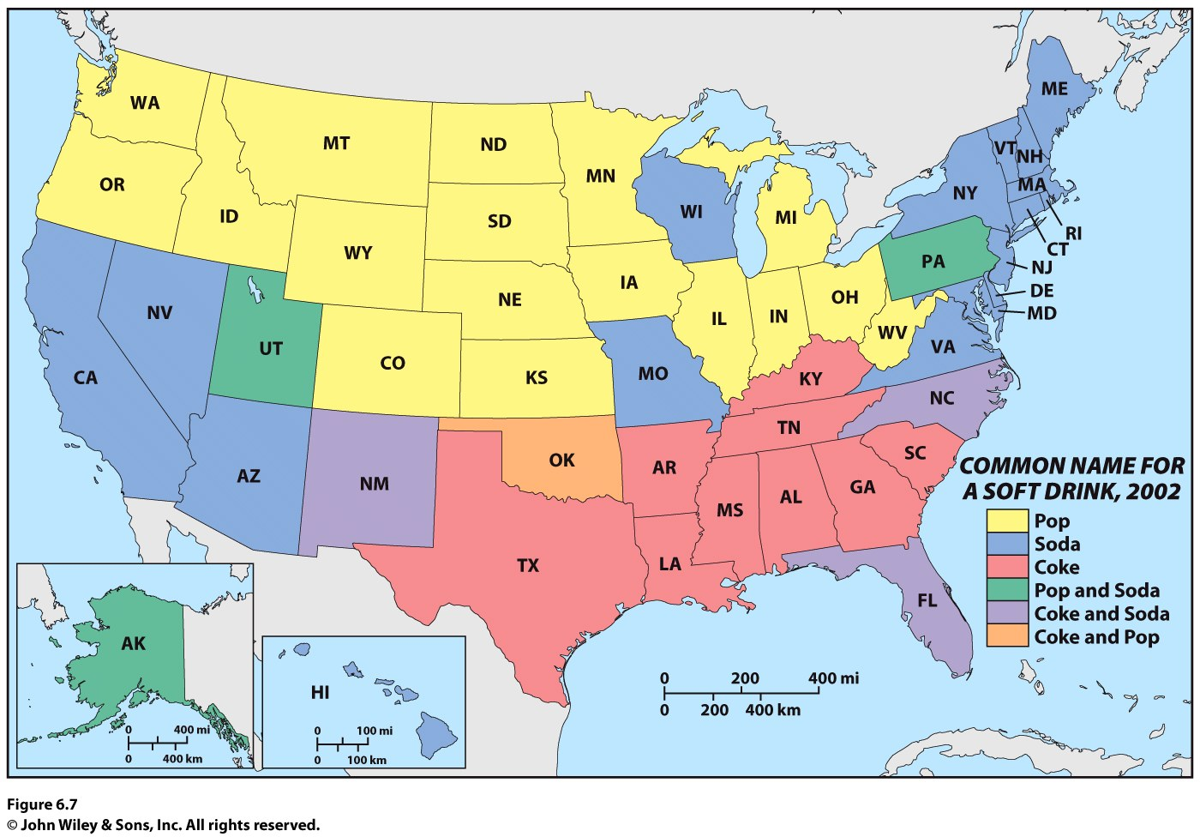

Slide 12
Key Question
Why are languages distributed the way they are?

Slide 13
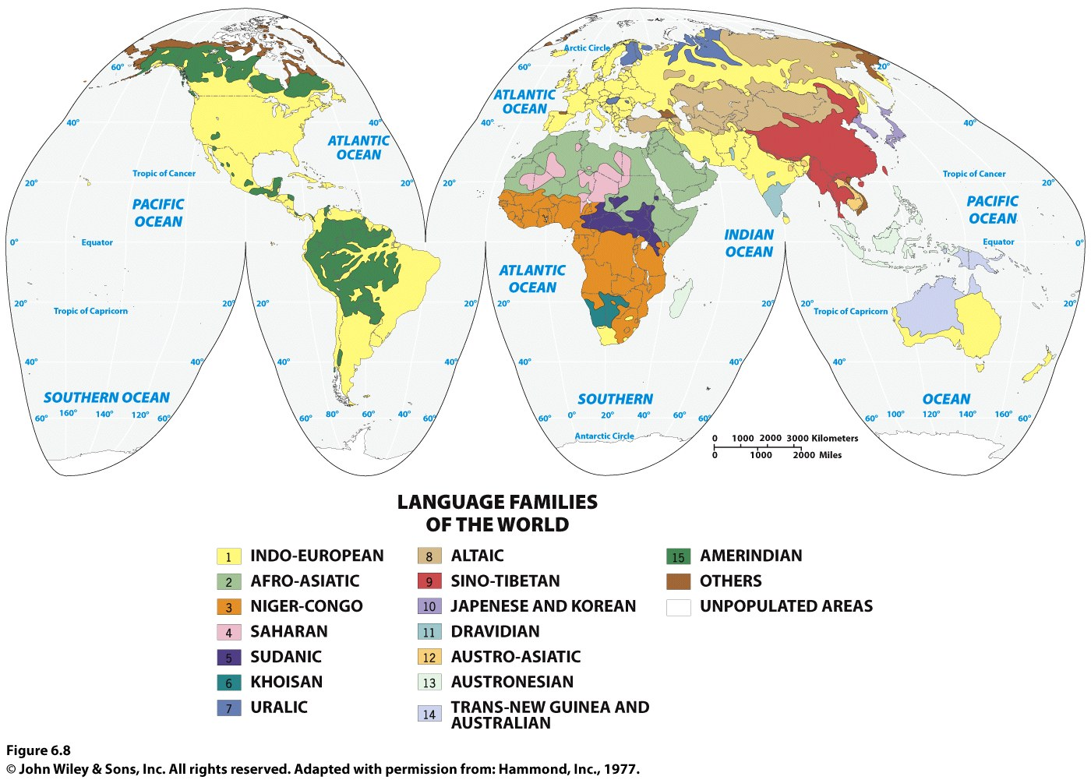
Language families Subfamilies

Slide 14
-Language family: group of languages with a shared but fairly distant origin (e.g., Indo-European, Sino-Tibetan,…)
Look at the map on the previous slide for the families
-

Slide 15
Definition and Debate
Why Are Languages Distributed the Way They Are?
The classification of languages is subject to intense debate.
Some linguists argue that there are not just a few but many dozens of language families.

Slide 16
Why Are Languages Distributed the Way They Are?
Language Formation
Sound shift is a slight change in a word across languages within a subfamily or through a language family from the present backward toward its origin
Ex.: Italian, Spanish and French as members of the Romance language subfamily
Proto-Indo-European language: first major linguistic hypothesis; from studies of Jakob Grimm and William Jones

