Slide 1
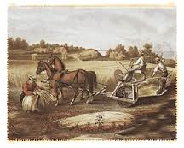
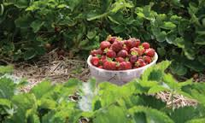
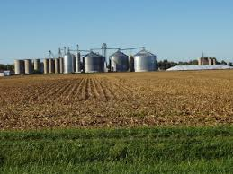

Slide 2
Environmental Effects of Ag.
Soil erosion
Desertification
Deforestation
Acquifer overuse
Chemicals

Slide 3
A) Soil erosion:
loss of nutrient rich top layer in top soil.
Don’t allow soil to regenerate bc/ over farming
7% of the topsoil is lost early
Prevent Soil Erosion?
https://www.youtube.com/watch?v=LpltrgkLqWc

Slide 4
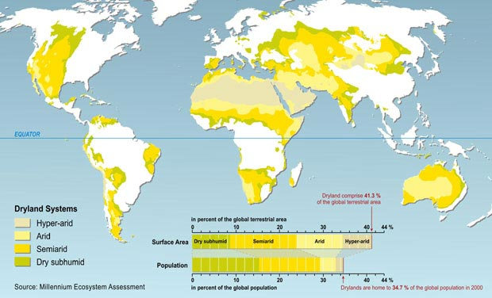
B)Desertification
Desertification occurs when:
the tree and plant cover that binds the soil is removed.
It occurs when trees and bushes are stripped away for fuelwood and timber, or to clear land for cultivation.
Overgrazing: animals eat away grasses and erode topsoil with their hooves.
intensive farming depletes the nutrients in the soil.
Wind and water erosion aggravate the damage, carrying away topsoil and leaving behind a highly infertile mix of dust and sand.
It is the combination of these factors that transforms degraded land into desert.
the Sahara alone has lost 270,000 sq. mi. of non-desert land over the past 50 yrs.

Slide 5
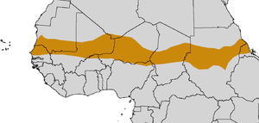
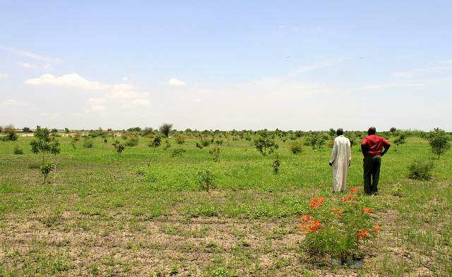
How to stop Desertification?
The Sahel region: a belt up to 1,000 km (620 miles) wide that spans the 5,400 km in Africa from the Atlantic Ocean to the Red Sea.
Examples: Sahel
The Great Green Wall is an initiative designed to stop the desertification of the semi-arid Sahel region in Africa. The essential idea is to plant a giant greenbelt of trees that would span Africa from Senegal to Djibouti. It also includes a number of other environmental, economic, and food security development initiatives aimed at addressing challenges resulting from desertification of the Sahel.

Slide 6
C) Deforestation:
in the 1980s, the Food & Agriculture Organization (FAO – part of the UN) studied its effects; determined that 44% of global tropical rainforests are already affected by cutting. 1% is logged every year; at this rate the entire equatorial forest would be gone in less than 90 yrs. Forests convert CO2 to oxygen counteract oxygen loss & greatly affect the oxygen cycle.

Slide 7
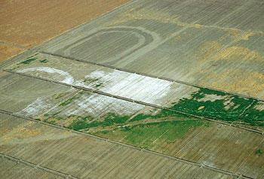
E)Salinization
- when irrigation is used in arid regions where evaporation rates are high SALINIZATION occurs
Salinization: accumulation of salt in the soil

Slide 8
F)Chemicals
1. fertilizers, pesticides, and fungicides also have an impact on the environment
Examples:
Production of fertilizers like ammonia uses large amounts of energy
Chemical runoff from fields treated with other chemicals pollute surface water and groundwater

Slide 9
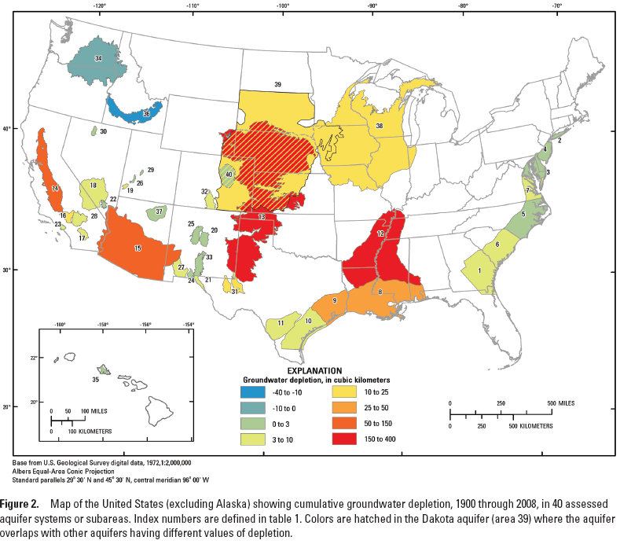
Groundwater Depletion
Groundwater depletion has been a concern in the Southwest and High Plains for many years, but increased demands on our groundwater resources have overstressed aquifers in many areas of the Nation, not just in arid regions. In addition, groundwater depletion occurs at scales ranging from a single well to aquifer systems underlying several states

Slide 10
What is Sustainable Agriculture?
Farming practices that carefully manage natural resources and minimize adverse affects on the environment while maintaining farm profits.
Examples:?

Slide 11
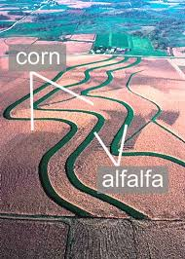
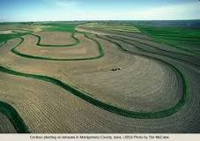
Practices
Water and soil conservation efforts are:
Contour plowing: which follows slopes of a field
Strip cropping: alternates the planting of row crops such as cotton with bands of sod crops like soybeans/alfalfa
No till farming: avoids agitating the soil with tractors drawn implements that remove weeds.
Crop rotations: to prevent crop diseases and pest problems; other definition too

Slide 12
Organic Agriculture
A farming system that promotes sustainable and bio-diverse ecosystems and relies on natural ecological processes and cycles as opposed to synthetic inputs such as pesticides.
Preserve natural resources and biodiversity
Support animal health and welfare
Provide access to the outdoors so that animals can exercise their natural behaviors
Only use approved materials
Do not use genetically modified ingredients
Receive annual onsite inspections
Separate organic food from non-organic food
Where?
1. Argentina, Australia and Argentina and Brazil are the largest areas of organic management.
2. Highest percentages of organic land are found in Europe because they are subsidized.
3. Africa and Latin America: exports most organic products.

Slide 13
Fair Trade
Fair Trade is a trading partnership, based on dialogue, transparency and respect, that seeks greater equity in international trade. It contributes to sustainable development by offering better trading conditions to, and securing the rights of, marginalized producers and workers – especially in the South.
Example:The average price per pound paid to farmers for Fair Trade Certified coffee in 2009 was $1.69, well above the average market price of $1.25.

Slide 14
Fair Trade and Gender Equity
Commitment to Non Discrimination, Gender Equity and Women’s Economic Empowerment, and Freedom of Association
The organization does not discriminate in hiring, remuneration, access to training, promotion, termination or retirement based on race, caste, national origin, religion, disability, gender, sexual orientation, union membership, political affiliation, HIV/Aids status or age.

