Slide 1
Development
AP HUG

Slide 2
Pre-Industrial World
-India & China possessed a substantial industrial base long before the Industrial Revolution.
-Britain sought legislative protection from Indian textiles in the 1700s, and availability of Egyptian cotton on the world market was also controlled. •
- Europe’s products may have lacked in quality of other areas, but their merchants were aggressive. The Dutch and British India companies

Slide 3
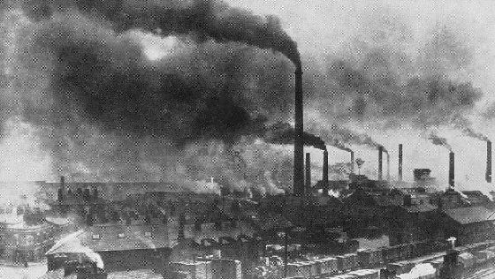
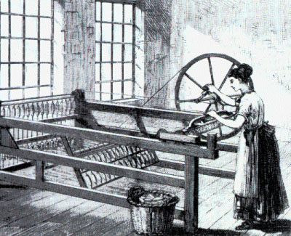
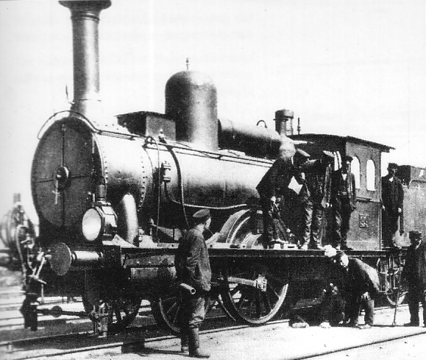
THE INDUSTRIAL REVOLUTION
Began in Britain in the late 1700’s (18th century)
Spread to the U.S. and Germany and the rest of Europe after that
Began with money from colonies and was brought on by the 2nd Agricultural Revolution which increased crop yields and allowed more people to move to cities to find work in factories
The Enclosure System also contributed to urbanization (small farmers lost land to wealthy landowners and moved to cities looking for work)

Slide 4
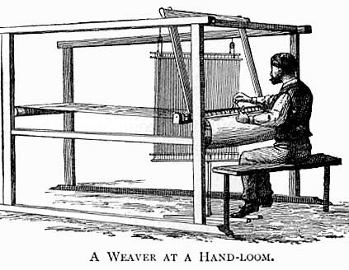
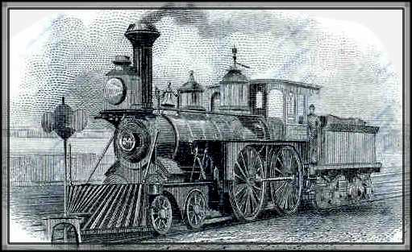
INDUSTRIALIZATION BRINGS INNOVATION
To improve textile manufacturing and shipping, key inventions were made in the 1700’s and early 1800’s:
The Spinning Jenny
The Flying Shuttle
The Cotton Gin
The Steam Engine

Slide 5
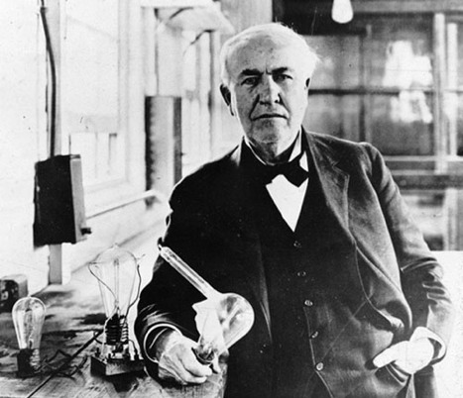
AND THE “SECOND” INDUSTRIAL REVOLUTION BROUGHT…
The telegraph
The telephone
The light bulb
The internal combustion engine
The radio
The airplane
All of these inventions came in the late 19th century

Slide 6
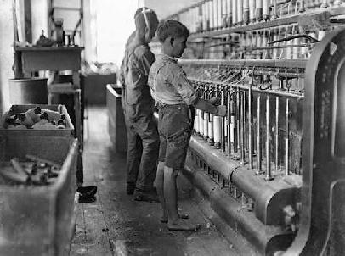
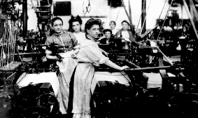
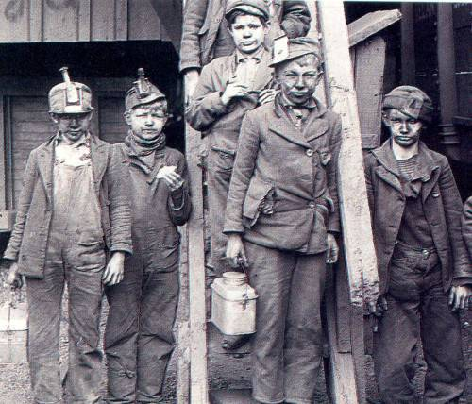
FACTORIES AND ASSEMBLY LINES
Made manufacturing more efficient and thus increased profits
Created jobs for people but these jobs were often very labor intensive and done in poor conditions
Women and children worked alongside men
Women had to do double duty as moms and workers
Children as young as six worked 16 hour days in deplorable conditions

Slide 7
Commodity Chain
China has become a crucial element in the emergence of global commodity chains. After more than 25 years of export oriented industrialization, China has captured a whole range of manufacturing activities, from the most simple and labor intensive to those with a growing level of sophistication. The footwear commodity chain is a notable example of a mature industry heavily dependent on low production costs and efficient distribution channels. Products tend to be relatively simple and success is commonly based on design, brand name and costs. It is thus a manufacturing sector that has achieved a high level of fragmentation due to globalization. From modest beginnings in the 1980s, footwear manufacturing has boomed in China, which now accounts for about 50% the world's shoe production. A brief commodity chain analysis reveals for this sector the following:
-95% of the shoes sold in the United States are manufactured in China, which in itself represents a significant commodity chain.
this commodity chain takes place in a context where the global apparel industry operates in a free trade environment. Since shoes are simple and labor intensive products, few countries maintain duties for this type of product, which can circulate with relative ease from a regulatory perspective.
In the case of shoe manufacturing in China, like many manufacturing activities, locational issues are simple as manufacturers choose sites close to port facilities.

Slide 8
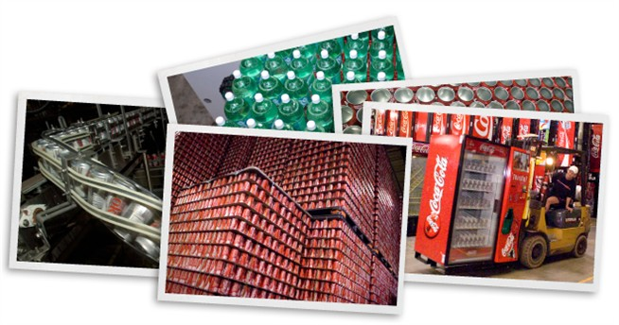
Bulk Gaining Industries
the production process adds weight to the goods. This often results in the supplier being located closer to the buyers or the markets to ease up on transportation costs.
Examples: The soda industry can be considered a bulk gaining industry as the finished soda bottle is heavier than the plastic bottle.

Slide 9
Break of Bulk Point
A break-of-bulk point is a location where transfer among transportation modes is possible. Manufacturers look for these when they are determining a location so that can minimize cost of transportation by rail, air, ship, or truck.

Slide 10
Bulk Reducing Industries
By placing a factory near an input, you can reduce the bulk of that product, such as copper. making it cheaper for transportation. So you would locate near the mines.
Copper is a bulk-reducing industry, an economic activity in which the final product weighs less than the input. By locating your industry near the mine, one minimizes transportation costs because you are not sending heavy packages and products to customers.

Slide 11
FORDIST
The manufacturing boom of the twentieth century can be traced in part to early innovations in the production process. Perhaps the most significant of these innovations was the mass‐production assembly line pioneered by Henry Ford, which allowed for the inexpensive production of consumer goods at a single site on a previously unknown scale. So significant was Ford's idea that the dominant mode of mass production that endured from 1945 to 1970 is known as Fordist.

Slide 12
Assembly Line
On the Ford assembly line, machines replaced people, and unskilled workers instead of craftsmen worked on the assembly lines. Ford paid his workers a good wage, and droves of job seekers migrated to the Detroit area to work in the automobile industry

Slide 13
Vertical Integration
Ford's goal was to mass produce goods at a price point where his workers could afford to purchase them. Production of automobiles at Ford's River Rouge plant in Dearborn, Michigan exemplified the vertical integration of production common during the Fordist period. Ford imported raw materials, from coal to rubber to steel, from around the world and brought them to his plant on the River Rouge in Dearborn, just west of Detroit. The massive River Rouge Ford plant is better described as an industrial complex. Ford's building complex had 93 buildings with more than 120 miles of conveyor belts that covered an area 1 by 1.5 miles

Slide 14
Bulk reducing Industries
An industry in which the final product weighs less or comprises a lower volume than the inputs.
Steel is an example of bulk reducing industry. Steel is made from a combination of coal, iron ore and flux.
Copper is an example of a bulk-reducing industry. The ore is heavy, so mills are located near the mines in order to “reduce the bulk” so that the final product costs less to transport.
http://www.history.com/topics/andrew-carnegie

Slide 15
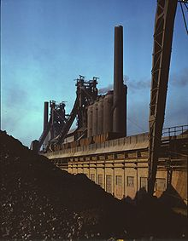
Steel
Iron is mined from the earth. There are three ways to process the iron into a usable form. One of them is to make steel. This is the most refined metal that can be made from iron. Most of the impurities are removed from the iron and it becomes a much stronger metal. There are several methods to make steel. The most modern and commonly used method is with an oxygen furnace. Very pure oxygen blows through melted iron and lowers the levels of impurities. Chemicals are also added to clean up sulfur and phosphorus. At this stage, other metals can be added to create different kinds of steel. One kind of steel is called stainless steel, which is resistant to rust. Among other uses, stainless steel is used in surgical instruments. 21:40min
http://www.youtube.com/watch?v=2QTGiHOZZFU

Slide 16
THE WHY OF WHERE OF STEEL

Slide 17
North America
Industrialization occurred first in the East. Served by a wide array of natural resources and supported by networks of natural as well as artificial transportation systems, remote from the destruction caused by wars in other industrial regions
American Manufacturing Belt—from the northeastern seaboard to Iowa, and from the St. Lawrence Valley to the confluence of the Ohio and Mississippi Rivers—is the largest in the world

Slide 18
North America
Manufacturing in North America is concentrated in the northeastern quadrant of the United States and in southeastern Canada.
Only 5 percent of the land area of these countries.., contains one-third of the population and nearly two-thirds of the manufacturing output.
This manufacturing belt has achieved its dominance through a combination of historical and environmental factors.
Early. . . settlement gave eastern cities an advantage. . . to become the country’s dominant industrial center.
The Northeast also had essential raw materials. . . and good transportation.
The Great Lakes and major rivers. . . were supplemented in the 1 800s by canals, railways, and highways.

Slide 19
Industrial Regions of North America
Fig. 11-4: The major industrial regions of North America are clustered in the northeast U.S. and southeastern Canada, although there are other important centers.

Slide 20
Manufacturing Value Change
Fig. 11-5: The value and growth of manufacturing in major metropolitan areas in the U.S. between 1972 and 1997.

Slide 21
Europe and Manufacturing
The Western European industrial region appears as one region on a world map.
In reality, four distinct districts have emerged, primarily because European countries competed with one another to develop their own industrial areas.
Eastern Europe has six major industrial regions.
Four are entirely in Russia, one is in Ukraine, and one is southern Poland and northern Czech Republic.

Slide 22
Manufacturing Centers in Western Europe
Fig. 11-6: The major manufacturing centers in Western Europe extend in a north-south band from Britain to Italy.

Slide 23
Rhine—Ruhr Valley
Western Europe’s most important industrial area is the Rhine—Ruhr Valley... in northwestern Germany, Belgium, France, and the Netherlands.
No individual city has more than one million inhabitants.
The Rhine divides .
The city of Rotterdam is near to where several major branches flow into the North Sea.
This location at the mouth of Europe’s most important river has made Rotterdam the world’s largest port.
Iron and steel manufacturing has concentrated in the Rhine—Ruhr Valley because of proximity to large coalfields.
Access to iron and steel production stimulated the location of other heavy-metal industries, such as locomotives, machinery, and armaments.

Slide 24
United Kingdom
The Industrial Revolution originated in the Midlands and northern England and southern Scotland, in part because those areas contained a remarkable concentration of innovative engineers and mechanics during the late eighteenth century.
The United Kingdom lost its international industrial leadership in the twentieth century.
Britain was saddled with outmoded and deteriorating factories and their “misfortune” of winning World War II.
The losers, Germany and Japan, received American financial assistance to build modern factories, replacing those destroyed during the war.
The United Kingdom expanded industrial production in the late twentieth century by attracting new high-tech industries that serve the European market.
Japanese companies have built more factories in the United Kingdom than has any other European country.
Today British industries are more likely to locate in southeastern England near the country’s largest concentrations of population and wealth and the Channel Tunnel.

Slide 25
Europe’s greatest industrial region is called:
a. the Paris Triangle
b. Saxony
c. Silesia
d. the Rühr

Slide 26
Russia and the Ukraine
Ukraine would be the largest territorial state and one of the most populous. It was a major manu­facturing center before the end of the nineteenth century, having been strongly affected by the Industrial Revolution. Coal from (Donbas) and iron ore from the Krivoy Rog reserve and later from Russia’s Kursk Magnetic Anomaly allowed Ukraine to grow into one of the world’s largest manufac­turing complexes.Today, despite Ukraine’s political separation from the former Soviet Union (and hence from Russia), Ukrainian and Russian industries are interdependent: Ukraine needs Russian fuels and Russia needs Ukrainian raw materials.

Slide 27
Manufacturing Centers in Eastern Europe and Russia
Fig. 11-7: Major manufacturing centers are clustered in European Russia and the Ukraine. Other centers were developed east of the Urals.

Slide 28
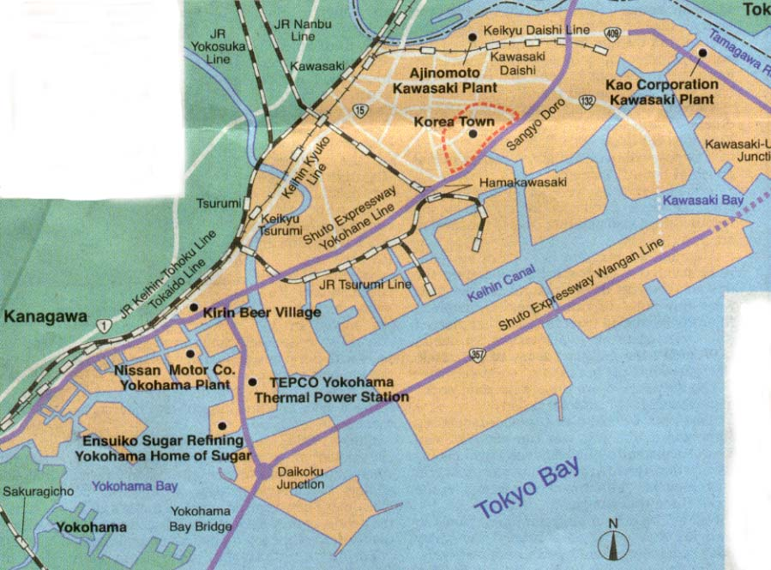
Kanto Plain
Kanto Plain, Japan’s largest plain. The climate is generally mild, and the four seasons are sharply delineated. This region, which includes such key cities as Tokyo. It is the most populous region of Japan. The hub of the region—the Tokyo-Yokohama district—is the core of Japan’s commerce and industry.The Keihin Industrial Zone and the Keiyo Industrial Region, extending along the shore of Tokyo Bay, form the largest industrial zone of Japan.

Slide 29
Manufacturing Centers in East Asia
Fig. 11-8: Many industries in China are clustered in three centers near the east coast. In Japan, production is clustered along the southeast coast.

Slide 30
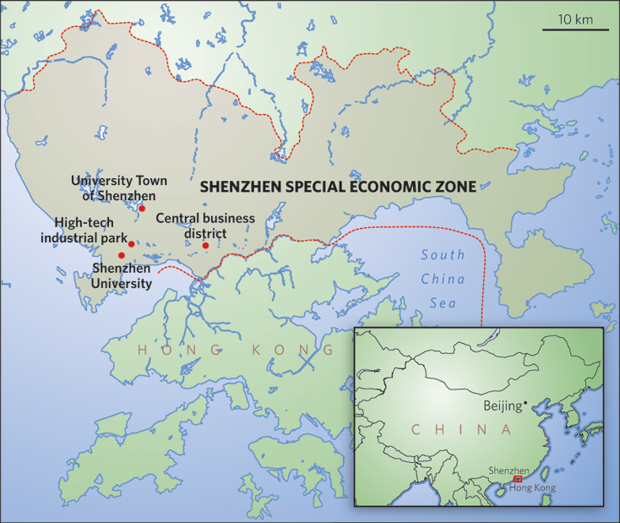
SEZs
Special Economic Zones (“SEZs”) are defined as geographical areas that offer special trade incentives to firms who choose to physically locate within them.
Many countries employ their own variations of these special enclaves, and in doing so use their own terminology to describe them. For example, Mexico refers to its zones as “maquiladoras,” Ghana, Cameroon, and Jordan have “industrial free zones,” the Philippines calls its economic zones “special export processing zones,” and Russia has “free economic zones.”
Ukraine closed their SEZ 2005???

Slide 31
Notes:
a

Slide 32
Notes:
a

Slide 33
Notes:
b

Slide 34
Notes:
e

Slide 35
Notes:
a

Slide 36
Notes:
d

Slide 37
Notes:
C

Slide 38
Notes:
a

Slide 39
Notes:
D

Slide 40
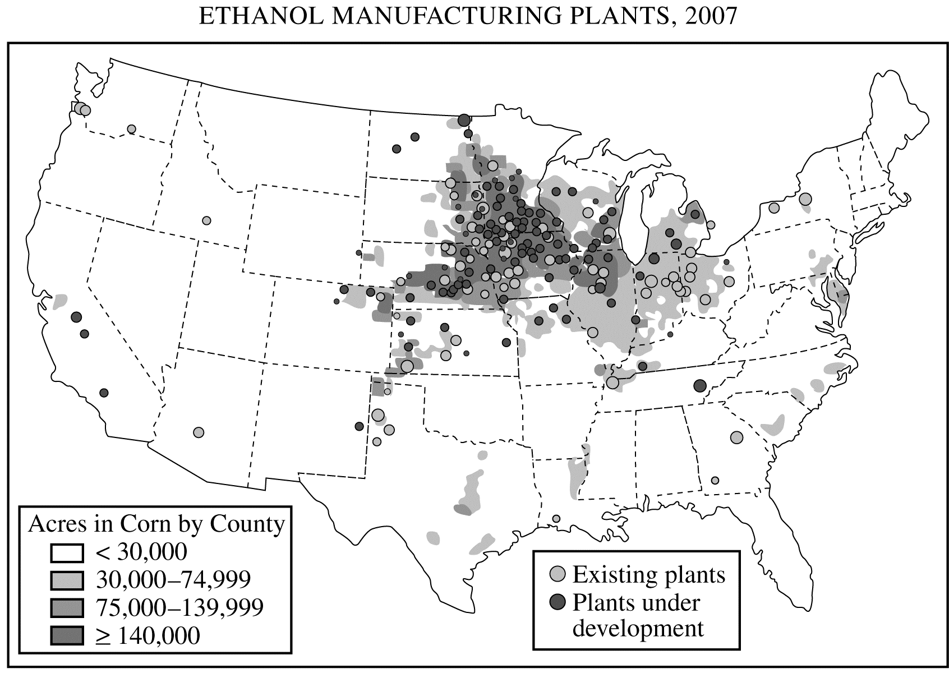
1. According to Alfred Weber’s theory of industrial location, three factors determine the location of a manufacturing plant: the location of raw materials, the location of the market, and transportation costs.
A. Using an example of a specific industry other than the one portrayed on the map above, explain under whatconditions an industry would locate near the market.
B. Using an example of a specific industry other than the one portrayed on the map above, explain under whatconditions an industry would locate near raw materials.
C. Using the map above and Weberian theory, explain the geography of ethanol plants in the United States.

Slide 41
A.Soft-drink bottling or Bread products are Weight/bulk are gained in processing/manufacturing; therefore the industry locates close to the market in order to minimize transportation costs
B. Copper smelting or Lumber products used for paper or furniture Weight/bulk are lost in processing/manufacturing; therefore the industry locates close to the source of raw materials in order to minimize transportation costs.
C.Corn is bulky; thus plants are built close to the supply of raw material in order to minimize transportation costs and maximize profit

Slide 42
Wood Unit 6 Practice Exam Answer Key
A
C
D
B
E
C
A
B
E
D
A
D
B
C
E
A
D
E
B
C
C
A
E
D
B

